Slide 1

LINCOLN TROJAN BAND FAMILY GUIDE
2026-2027

Slide 2
WELCOME!
We are glad you are here
In the next slides we will give you an overview of the Lincoln Trojan Band and Booster Organization

Slide 3
INTRODUCTIONS

Slide 4
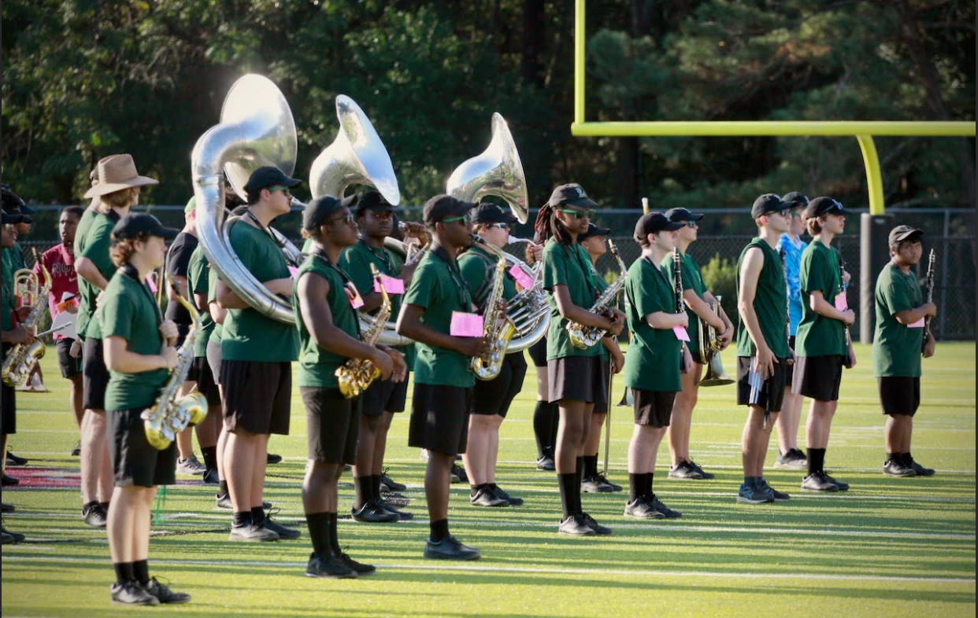
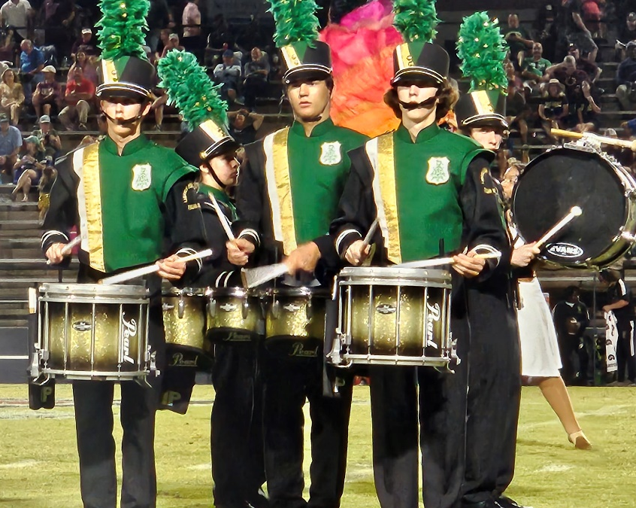
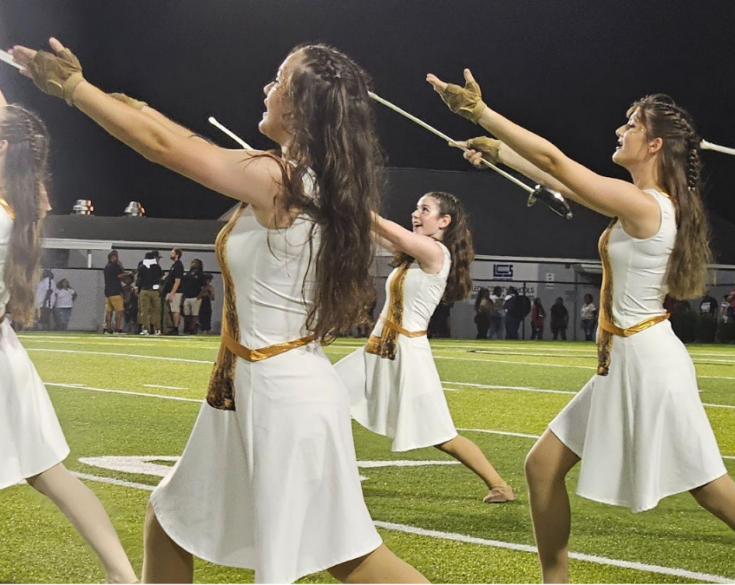
THE LINCOLN TROJAN BAND
WINDS
PERCUSSION
COLOR GUARD
Woodwinds & Brass
Drumline & Front Ensemble
Dance, Flag, Rifle, Sabre

Slide 5
TROJAN BAND STAFF
HANNAH HAUGEN
hannah.haugen@leonschools.net
“all students will become two things once they leave after four years: great people, and great musicians.”
BAND DIRECTOR
MARCHING INSTRUCTORS
Gianna Leto
Adam Zierden
COLOR GUARD INSTRUCTORS
Sarah Mahan
TBD
PERCUSSION INSTRUCTORS
Alyssa Coleman
TBD

Slide 6
Lincoln Trojan Band Boosters

Slide 7
OVERVIEW
The Lincoln Trojan Band Boosters is a parent support organization for the Lincoln Trojan Band. The mission of the Boosters is to encourage the growth and development of a quality band program which complements and extends the educational options for all Trojan Band students.
Every parent or guardian with a student in any Lincoln Trojan Band is automatically a member of the Lincoln Trojan Band Boosters.
Band Boosters:
Is organized exclusively for charitable and educational purposes and is a 501(c)(3) corporation called Lincoln Band Boosters, Inc.
Provides financial assistance to and promotes the general welfare of the Lincoln Trojan Band in cooperation with the school administration.
Provides inspiration, guidance and assistance to all band students and staff in order to develop and sustain a top performing instrumental music program at all levels.
Ensures clear communication and cooperation between parents, students, teachers, directors and staff.
Promotes music culture throughout the community by fostering greater performance, attendance and other public support of all band activities.

Slide 8

TROJAN BAND BOOSTER EXECUTIVE BOARD
Elected Board Positions
Booster President
Vice President
Treasurer
Secretary
Presides at booster & board meetings; liaison between director and board; oversees board functions and events; assists as needed
Backup to all board positions; coordinates photos and senior traditions; assists as needed
Manages booster financials; provides quarterly reports; pays clinicians; deposits funds; processes lesson academy and accompanist charges/payments; completes annual tax forms; coordinates reimbursements
May complete student account tasks if needed
Leads parent/family communication; tracks form submission; works closely with communication committee; takes meeting notes
Current President
Patricia Atchley
Current VP
Hayley Scott
Current Treasurer
Tracy Edewaard
Current Secretary
Casey Fisher

Slide 9
WE RUN ON VOLUNTEERS AND WE NEED YOUR HELP!
Non-Elected/Volunteer
Positions & Committees
Outreach
Fundraising
Sponsorships
FSU Volunteering
Color Guard Reps
Volunteer Coord.
Regularly posts on Facebook and Instagram
Maintains band calendar
Maintains band website
Facilitates monthly fundraisers
Publicizes fundraisers (flyers, forms, etc.)
Coordinates pickup/distribution of items
Reports profits to student accounts
Provides sponsorship docs and forms each year
Orders and hangs signage & coordinates website advertising
Communicates with sponsors and families
Coordinates all aspects of volunteering for FSU games
Communicates with Volunteers
Tracks and reports volunteer hours
Liaise with FSU Sports Shop
Works with director to plan events, trips, etc.
Secures hotels, vans, etc.
Works with treasurer for reimbursements
Assists guard instructors as needed
Creates volunteer signups & ensures we have enough coverage
Reports volunteer hours to LHS
Ensures volunteers & chaperones are approved by the district
Current Coord:
Danielle Morales
Current Coord:
Teena B & Lisa R
Current Coord:
Carrie Fraser
Current Coord:
Stacy Ball
Current Coord:
Tia W & Andrea G

Slide 10
26-27 BOOSTER BOARD
NEW BOARD CONTACT INFO
26-27 President: Hayley Scott
26-27 Vice President: David Thayer
26-27 Treasurer: Patricia Atchley
26-27 Secretary: Casey Fisher
LTBBOOSTERS@GMAIL.COM IS BEING RETIRED. USE THESE NEW EMAILS STARTING JUNE 1!
President: president@lincolntrojanband.com
Vice President: vicepresident@lincolntrojanband.com
Treasurer: treasurer@lincolntrojanband.com
Secretary: secretary@lincolntrojanband.com

Slide 11
26-27 COORDINATORS
Our Coordinators would love your help.
There’s always too much for 1 person to do!
Please reach out if you are interested in helping in any capacity.
Outreach
Fundraising
Sponsorships
FSU Volunteering
Color Guard Reps
Volunteer Coord.
Regularly posts on Facebook and Instagram
Maintains band calendar
Maintains band website
Facilitates monthly fundraisers
Publicizes fundraisers (flyers, forms, etc.)
Coordinates pickup/distribution of items
Reports profits to student accounts
Provides sponsorship docs and forms each year
Orders and hangs signage & coordinates website advertising
Communicates with sponsors and families
Coordinates all aspects of volunteering for FSU games
Communicates with Volunteers
Tracks and reports volunteer hours
Liaise with FSU Sports Shop
Works with director to plan events, trips, etc.
Secures hotels, vans, etc.
Works with treasurer for reimbursements
Assists guard instructors as needed
Creates volunteer signups & ensures we have enough coverage
Reports volunteer hours to LHS
Ensures volunteers & chaperones are approved by the district
26-27 Coord:
Danielle Morales
26-27 Coord:
Teena B & Lisa R
26-27 Coord:
Carrie Fraser
26-27 Coord:
Stacy Ball
26-27 Coord:
Kaity L & Kim C
26-27 Coord:
vacant

Slide 12
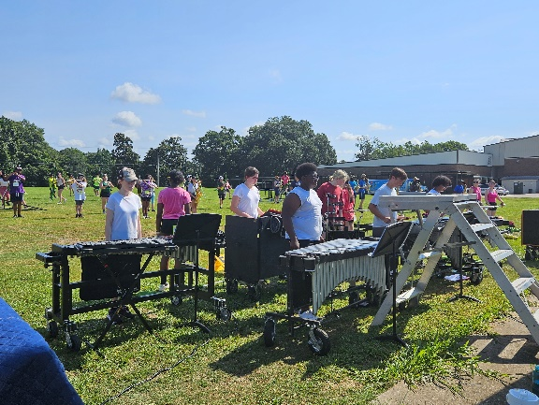
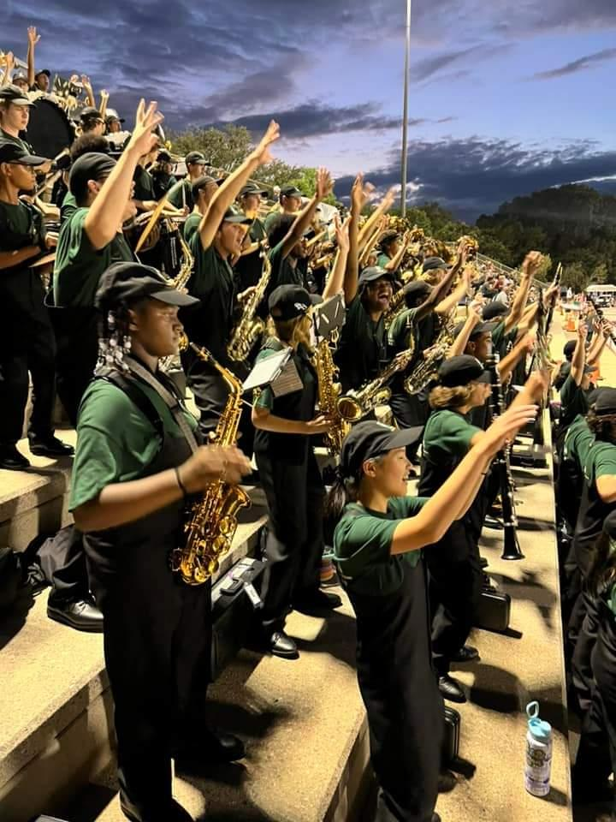

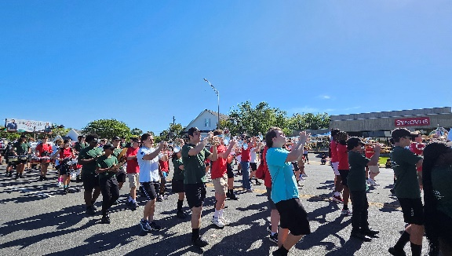
VOLUNTEER OPPORTUNITIES
Even if you are not on the booster board or leading a committee, we need your help!!
We ask for you to volunteer for a minimum of 3 events – we have so many to choose from!! Sign up to volunteer on CutTime
Marching Rehearsals Tues and Thurs 5:30-8pm
Football Games Most Fridays Aug-Oct
FSU Games Home Games MERCH! Not food
Other Band Events Rehearse-A-Thon Competition MPA, Parades

Slide 13
VOLUNTEERS AND CHAPERONES
Volunteers
Chaperones
Interact with students under the supervision of the band director.
Must fill out a Leon County Schools volunteer application each year
Cost = FREE
MAY interact with students in an unsupervised environment.
Must fill out a Leon County Schools volunteer application each year (check the Field Trip Chaperone Checkbox) AND
Must pass a Level 2 background check AND
Must get fingerprinted WITH Leon County Schools
Cost = $61 (good for 5 yrs)
Can volunteer for all positions EXCEPT Riding the Bus
Can volunteer for all positions INCLUDING Riding the Bus

Slide 14
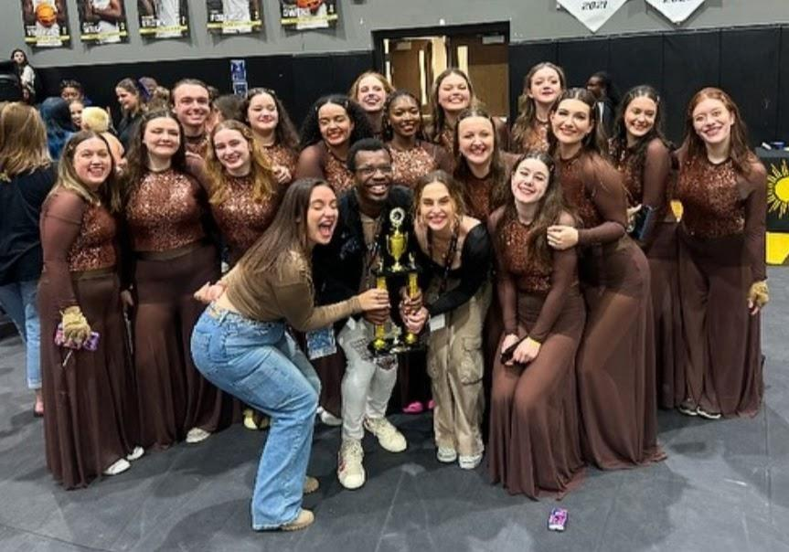
CUTTIME
What is it and why do I need it?

Slide 15
CUT TIME
What is it?
How do I register?
Website
We use it for:
Keeping track of your student’s band account & current fee balance
Fees (e.g., band fees, lessons academy)
Orders
Payments
Emails & Announcements
Volunteering
Ordering & Fundraising
You will receive a registration email or text
Click the link in the email or text
That’s it! The link is unique to you. No username or password.

Slide 16
NEW / IMPROVEMENTS WE WILL SEE WITH THE MOVE TO CUTTIME
NO NEED TO LOG IN
No username/password. No registration
You will get a text and email with a link. Bookmark it. That is your unique link to your CutTime account.
CLEAR ACCOUNT BALANCE DETAILS & AUTOMATIC CREDIT APPLICATION
When you click your link and log in to CutTime, you will see your account balance clearly at the top of your screen as soon as CutTime opens.
CLEARER SEPARATION BETWEEN LHS CHARGES/PAYMENTS AND BOOSTER CHARGES/PAYMENTS
We are going to try very hard to work on clearing up and simplifying these differences.
We are also going to try to leverage CutTime for more online payments to boosters to reduce your need to write checks/send cash.

Slide 17
IMPORTANT NOTE FOR RETURNING STUDENTS
WE WILL BE TRANSFERRING YOUR FINAL FEE BALANCE FROM BOOSTERHUB TO CUTTIME IN MAY
We will send out additional details in May.
We will set a cutoff date, and whatever your fee balance is at that point will be your starting balance in CutTime.
We WILL NOT be able to transfer all of your account details to CutTime - only your balance as of that May date. However, we will export all account details from BoosterHub to have as a reference if needed.

Slide 18

CUT TIME TIMING
Look for your Cut Time link in JUNE
We will begin adding students and parents to Cut Time in June
Fill out the Parent & Student Information form NOW
This is what we will use to add you to Cut Time (returning students please do this as well. We need your most current and accurate email and phone number – NO LEON COUNTY SCHOOLS EMAIL ADDRESSES PLEASE!)
2 IMPORTANT NOTES:
We need a NON-SCHOOL email for your student
The Leon county schools email address blocks emails. Students will not be able to receive their CutTime link email at a school address. PLEASE PROVIDE A GMAIL, HOTMAIL, ICLOUD, ETC. FOR YOUR STUDENT.
Students cannot use the same email as their parent – the emails must be UNIQUE
Parent: iamaparent@hotmail.com
Student: iamaparent@hotmail.com
iamastudent@gmail.com
2594335674@leonschools.net
Parent: iamaparent@hotmail.com
Student: iamastudent@gmail.com

Slide 19
COMMUNICATION
www.LincolnTrojanBand.com
Cut Time (emails, announcements)
Remind
BandApp (guard and percussion)

Slide 20
YOU WILL GET A LOT OF INFORMATION
Emails & Texts (sent from CutTime)
This Week email on Sundays from Ms. Haugen
Booster Newsletters on Wednesdays during Marching Season
Make sure CutTime emails don’t land in your junk folder
Remind
Download the app and Join the Band remind: Text @TBAND2627 to 81010
LincolnTrojanBand.com
Our website has info about the Booster Board, making payments, sponsorships, fundraisers, and more!
Band App
Only used by percussion and color guard.
3 BEFORE ME
Check 3 of these resources before you ask – it’s very likely your question is answered somewhere!

Slide 21
Who Should I Ask?
Is the question about your student’s grade, performance, behavior, attendance?
Email Ms. Haugen
hannah.haugen@leonschools.net
YES
General Questions
president@lincolntrojanband.com
Color Guard Questions
TBD@lincolntrojanband.com
NO
Communication
secretary@lincolntrojanband.com
Sponsorships
TBD@lincolntrojanband.com
Email Boosters
Band Fee / Accounts
treasurer@lincolntrojanband.com
Fundraising
TBD@lincolntrojanband.com
FSU Sports Shop
srcball@gmail.com
Social Media /Website /Calendar
outreach@lincolntrojanband.com

Slide 22
What’s a Shako?
A small vocab lesson before we dive in to uniform details!

Slide 23
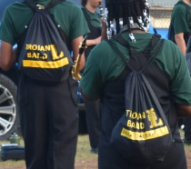
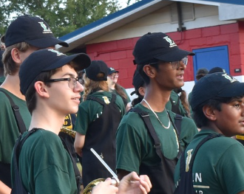
VOCAB FOR BAND FAMILIES
Sub Shirt/Shorts
String Bag
Hat/Visor
Green Lincoln band shirt worn under marching uniform. All black shorts of your choice with no other colors or large obvious logos.
Lincoln bag that students take to events to carry personal items. Has their name and section written on it.
Lincoln hat required for events. Visors may be used if hair/hairstyle prevents wearer from using a ballcap. Front ensemble wears this instead of shakos.

Slide 24
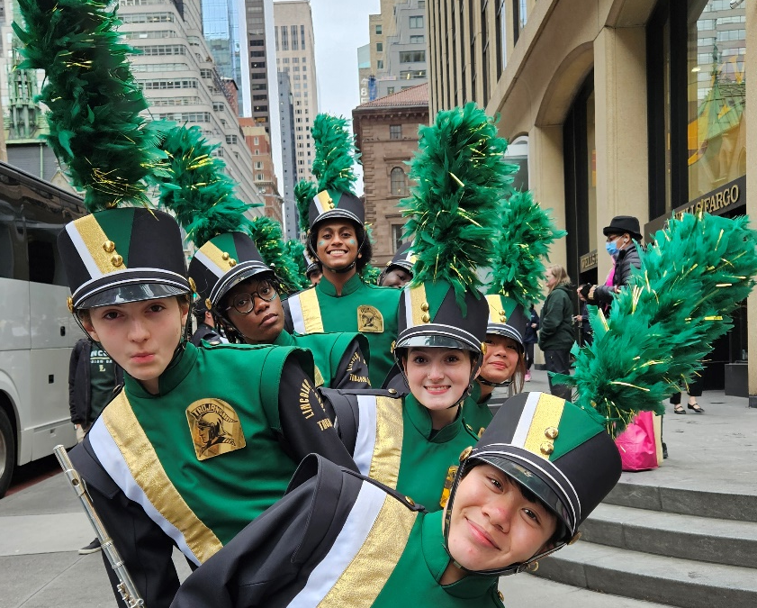
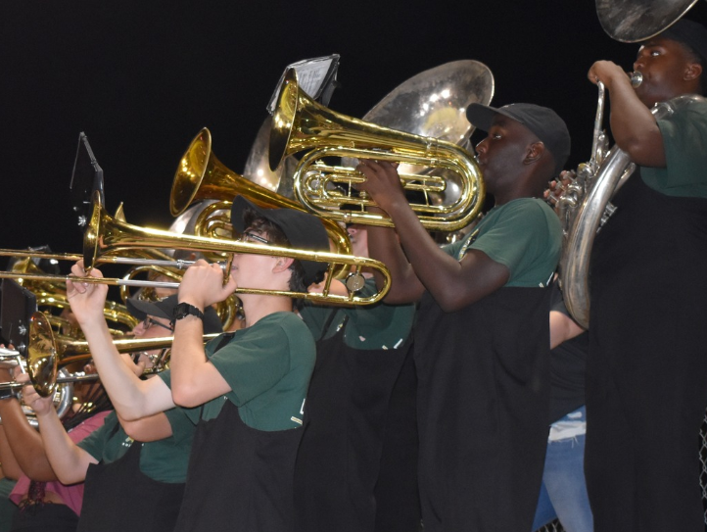
VOCAB FOR BAND FAMILIES
Band Shoes
Bibbers
Shako / Plume
Black shoes for marching. Can also be worn for concerts. Sometimes referred to as “Bandos”.
Black overall style pants that are worn under the marching jacket.
Plumes sit atop the shako. Volunteers are needed at every performance to assist students with adding plumes to shakos.

Slide 25
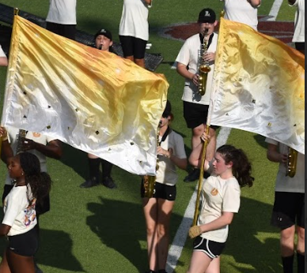
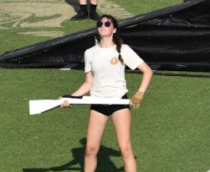
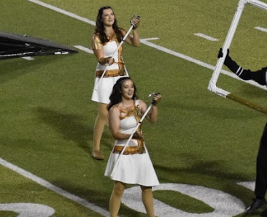
VOCAB FOR BAND FAMILIES
Flag
Rifle
Sabre
Color Guard uses Flags to add visuals to the show. They are a standard piece of guard equipment.
Rifles are more advanced guard equipment. Guard will have tryouts to determine who will use a rifle in the show.
Sabres are more advanced guard equipment. Guard will have tryouts to determine who will use a sabre in the show.

Slide 26
Uniforms and Required Items

Slide 27
Required Items for Marching Season – WINDS & PERCUSSION
Sub Shirt
Show Shirt (cost included in band fee)
Baseball Cap, Visor or Beret (tubas only)
String Bag
Band Shoes
Gloves (except percussion)
Percussion Items (new percussion only)
Flip Folder & Lyre (CAN be purchased on your own)
Tall Black Socks*
Black shorts*
Lincoln Water JUG - NEW THIS YEAR
Practice Shirt - NEW THIS YEAR
Order and Pay in JULY (before band camp)
You will get an email when ordering opens.
* Must be purchased on your own (Target, Walmart, etc.). Must have by start of camp.

Slide 28
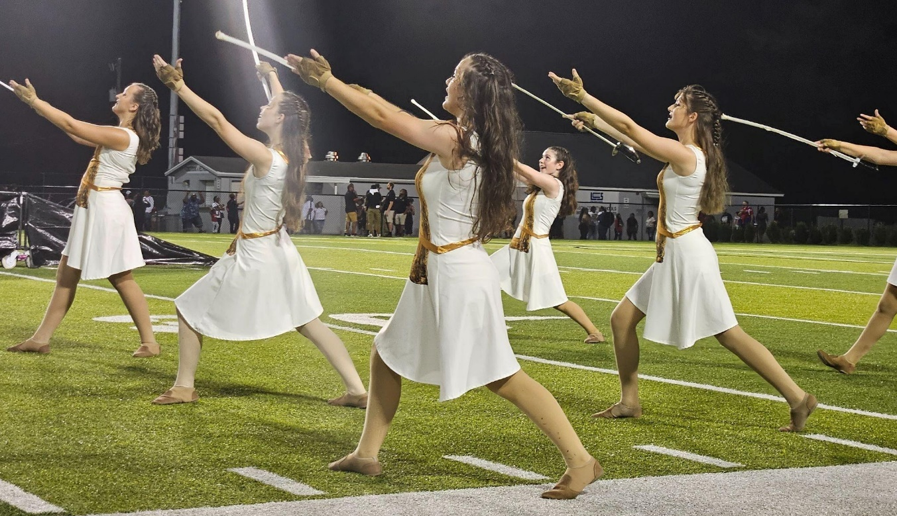
Required Items for Marching Season – COLOR GUARD
Show Shirt (cost included in band fee)
Uniform
Warm-up Jacket
Duffle Bag
Poms
Jazz Shoes
Black Shirt / Leggings*
Makeup, Undergarments*
Lincoln Water JUG - NEW THIS YEAR
Practice Shirt - NEW THIS YEAR
Order and pay in JULY (before band camp). You will get an email when ordering opens.
Color Guard staff will communicate about Uniform sizing and ordering on the Band App.
* Must be purchased on your own (Target, Walmart, etc.). Must have by start of camp.

Slide 29
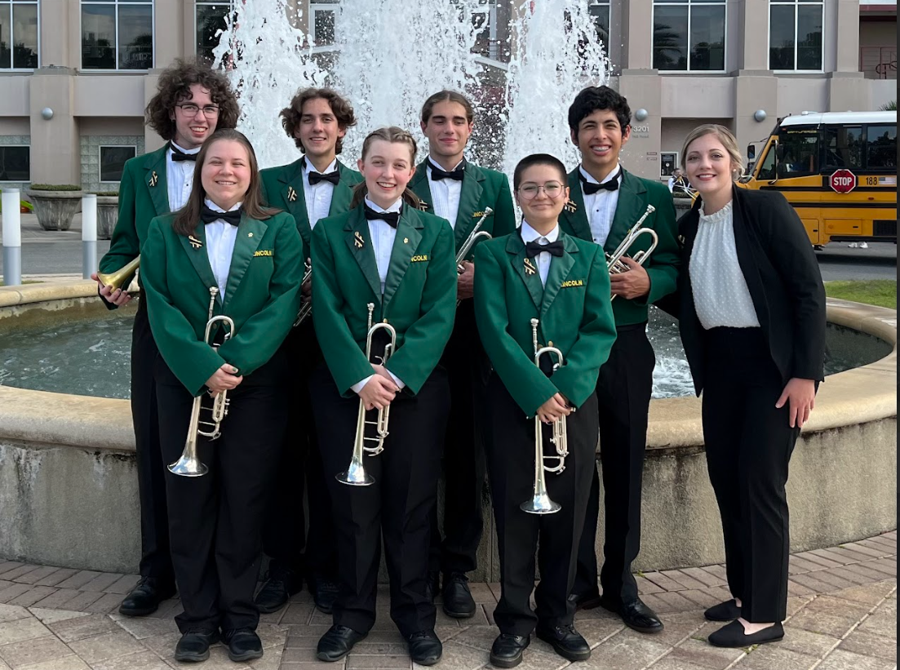
Required Items for Concert Season
Concert Shirt (tux shirt)
Concert pants (tux pants)
Black Bowtie
Black Cummerbund
Black dress shoes (can wear marching shoes)
Jacket (provided by LHS)
Order and pay in SEPTEMBER. You will get an email when ordering opens.

Slide 30
Required Items for Winter Guard
Same items as marching season
Warm-up Jacket
Duffle Bag
Jazz Shoes
Makeup, Undergarments
Lincoln Water JUG
PLUS - Winter Guard Uniform
Color Guard staff will communicate about Uniform sizing and ordering on the Band App.

Slide 31
Where to Order WINDS & PERCUSSION
Order through LHS
Purchase on Your Own
ORDERING WILL OPEN IN JULY
Sub Shirt
Show Shirt
Hat (cap, visor, or beret for tubas)
String Bag
Band Shoes
Gloves (except percussion)
Percussion Items (new percussion only)
Lincoln Water Jug
Practice Shirt
ORDERING WILL OPEN IN SEPTEMBER
Concert Tux Shirt (can also purchase on your own)
Concert Tux Pants (can also purchase on your own)
Black Bowtie (can also purchase on your own)
Black Cummerbund (can also purchase on your own)
Black Shorts Needed by LAST day of Band Camp
Tall Black Socks Needed by LAST day of Band Camp
Black Dress Shoes Needed by Fall Concert – can wear marching shoes

Slide 32
Where to Order COLOR GUARD
Order through LHS
Purchase on Your Own
ORDERING WILL OPEN IN JULY
Show Shirt (cost included in band fee)
Uniform*
Warm-up Jacket
Short-sleeve Baseball Jersey
Duffel Bag
Poms
Jazz Shoes
Lincoln Water Jug
Practice Shirt
Black Shirt/Leggings Needed by LAST day of Band Camp
Makeup Needed by LAST day of Band Camp
Tights/ Undergarments Needed when uniforms arrive – Staff will inform
Gloves (rifle and saber only) Needed by first day of Color Guard Camp
* Color Guard staff will communicate about uniform sizing and ordering on the Band App.

Slide 33
Uniform Fittings & Item Distribution for WINDS & PERCUSSION (not req. for guard) Saturday, July 25th 10am – 2pm
Check In
Get Trained
Pick up the items you ordered
Get Fitted for a Shako
Get Fitted for a Marching Uniform & Concert Jacket
You’re Done!
All items should be ordered PRIOR to this date!

Slide 34
Let’s Talk Money
What’s all this gonna cost?

Slide 35
Band Fee – What’s included?
$575
Band Fee covers Marching and Concert Seasons for Winds & Percussion and Marching Season for Color Guard (Winter Guard is an additional fee)
50% due by Nov 30 50% due by April 1
Marching Season
Concert Season
Marching uniform, maintenance, and cleaning
Guard Uniform
Show shirt
Transportation to and from football games, competitions, parades, etc.
Equipment truck rental
Food & drinks (pizza at football games, lunch on competition days, etc.)
Instrument repairs and service
Flags and Guard equipment
Equipment/props purchase and maintenance
Music purchases and supplies
Show design, drill, music arrangements, etc.
Association fees, Music Performance Assessments
Concert Jacket, maintenance, and cleaning
Transportation to and from MPA
Equipment truck rental
Food & drinks for select events
Instrument repairs and service for Lincoln equipment
Music purchases and supplies
Association fees, Music Performance Assessments
One entry into Solo/Ensemble
If your student is ONLY doing CONCERT Season
Must be approved by director
$200

Slide 36
Percussion & Color Guard Fees
Percussion Fee
Winter Guard Fees
Instrument repairs and service
Music purchases and supplies
Sticks, Mallets, and other percussion-specific equipment
This fee will be determined after Marching Season
Due by Nov 30
$60
TBD

Slide 37
Additional Costs Not Included in Fees
Marching Season
Concert Season
(Winds & Percussion)
Winds & Percussion
Required Items (t-shirt, hat, shorts, shoes, string bag, water cooler, etc.)
Lyre and Flip Folder (prices vary based on instrument)
Percussion items (new percussion students only)
Equipment Rental (if applicable; rent through Playground Music or Music Masters)
Color Guard
Required Items (shoes, gloves, jacket, duffle, makeup, etc.)
All Students
Funds for one meal at out-of-town events
Required Concert Uniform* (concert shirt, pants, cummerbund, bowtie)
Solo & Ensemble Entry Fees (beyond ONE entry - optional)
Solo & Ensemble Accompanist Fees
Approximate Cost
$90
Optional Items
Band Swag (section hoodies, magnets, t-shirts, etc.)
Tickets to optional events like FSU Prism Concert
Banquet Tickets (Senior students do not pay for banquet tickets)
Approximate Cost
$200

Slide 38
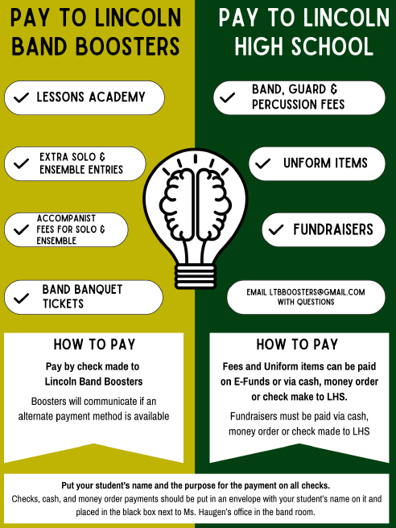
How Do I pay? Who do I pay?
Here’s a tutorial!
IMPORTANT FOR CHECKS & CASH:
YOU MUST LABEL IT with your student’s name and the payment purpose
YOU MUST PUT IT IN THE BLACK BOX which is next next to Ms. Haugen’s office in the band room.
We do not recommend mailing checks to the school – they get so many that it takes a lot longer to process.
The box is checked once a week - we try to check more frequently at the beginning and end of the year when the majority of payments come in.
Efunds is NOT connected to CutTime - volunteers enter those payments manually on your account. Please allow 1-2 weeks for us to get payments added to your account in CutTime. Efunds usually isn’t available until late July

Slide 39
Fundraising

Slide 40
We will have lots of opportunities to fundraise to cover fees.
Even if you pay fees in full on day 1, we still encourage participation to help boost the general band and booster funds!
Sponsorships
FSU Sports Shop
Monthly Events
DIY Calendar Idea
Reach out to local companies or friends and family. Ask them to sponsor the band. 50% or 40% of the money goes toward your child’s band fees (depending on date submitted). More info on our website.
Volunteer to sell FSU merch at the Home FSU games and receive $25 per person, per game toward band fees.
This is the only volunteer event that earns toward band fees. Students may wish to use this for service hours instead.
Lucky Goat
Poinsettias
Share Nights
We will have at least one fundraising opportunity each month. Each event flyer will indicate how the profits are divided.
Use social media to ask for donations
Pick a day and donate that amount to the student.
(This is a personal fundraiser only.)

Slide 41
FUNDRAISING – How to do it!
Event | Profit | Amount Sold | Total Earning Possibility
FSU Sports Shop | $25/person/game | 4 games x 2 people | $200
Lucky Goat Fall | $4.50/bag | 15 bags | $67.50
Lucky Goat Spring | $4.50/bag | 15 bags | $67.50
Rehearse-A-Thon | 50% of donations | $150 in donations | $75
Poinsettias | $4/plant | 20 plants | $80
Sponsorships | 50% of sponsorship | $200 in sponsorships | $100
 |  | Total Earned | $590
Sponsorships can start now!! Start talking to businesses to see if they want to sponsor the band for next year. 1 Platinum Sponsor will cover 87% of your band fee!
We will post sponsorship details and deadlines at LincolnTrojanBand.com

Slide 42

New Sponsorship Incentive this year
Get a Platinum or Gold Sponsor and get all sponsor info (form, payment, logo) turned in by June 26th, and the sponsor’s logo will be printed on the back of our new practice shirts.

Slide 43
This is a lot of info – what do I need to do RIGHT NOW?

Slide 44
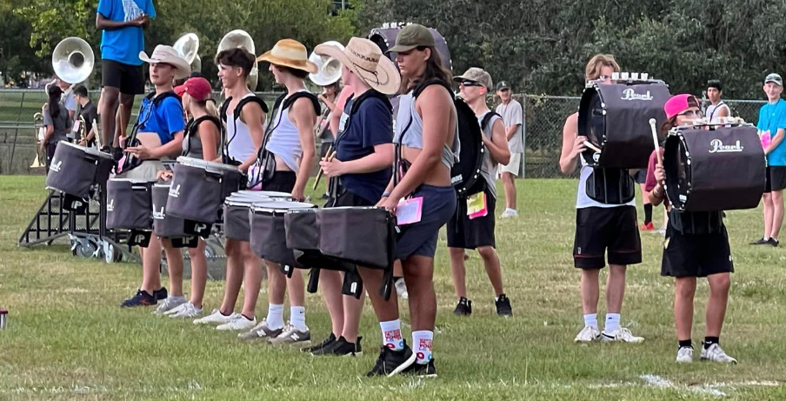
BAND CHECKLIST
Review all the information you received today & check out our Website!
Complete the Parent & Student information form
Go get some Sponsorships!!
Join the 26-27 Band Remind Group
Color Guard and Percussion – make sure you have the band app to communicate with instructors
Look for CutTime info in June
Get ready for BAND CAMP!

Slide 45
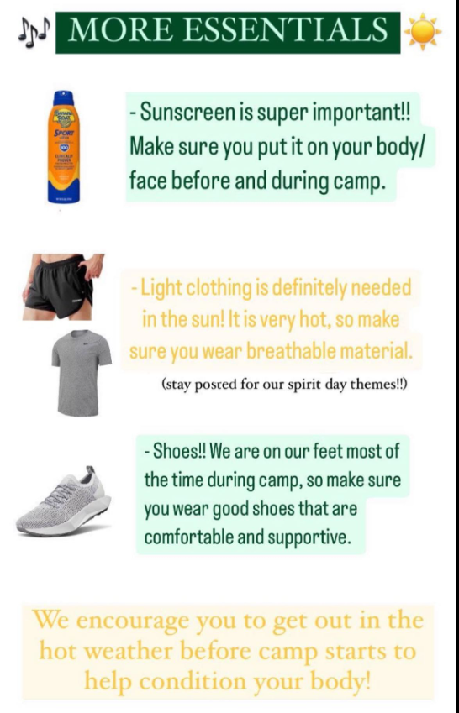
STUDENTS We’ll see you at band camp!
REQUIRED ITEMS FOR CAMP
Sunscreen
Hat (Sunglasses optional but helpful)
Water – go get a LARGE ½ gallon or bigger water bottle
LUNCH – bring a packed lunch – there’s not time to run out and get anything (for those who drive)
Athletic Clothes (light colors)
Athletic Shoes (no crocs or sandals!)
Flip Folder & Lyre (not percussion or guard)

